Slide 2
Teacher:
Class Days and Times:

Slide 3
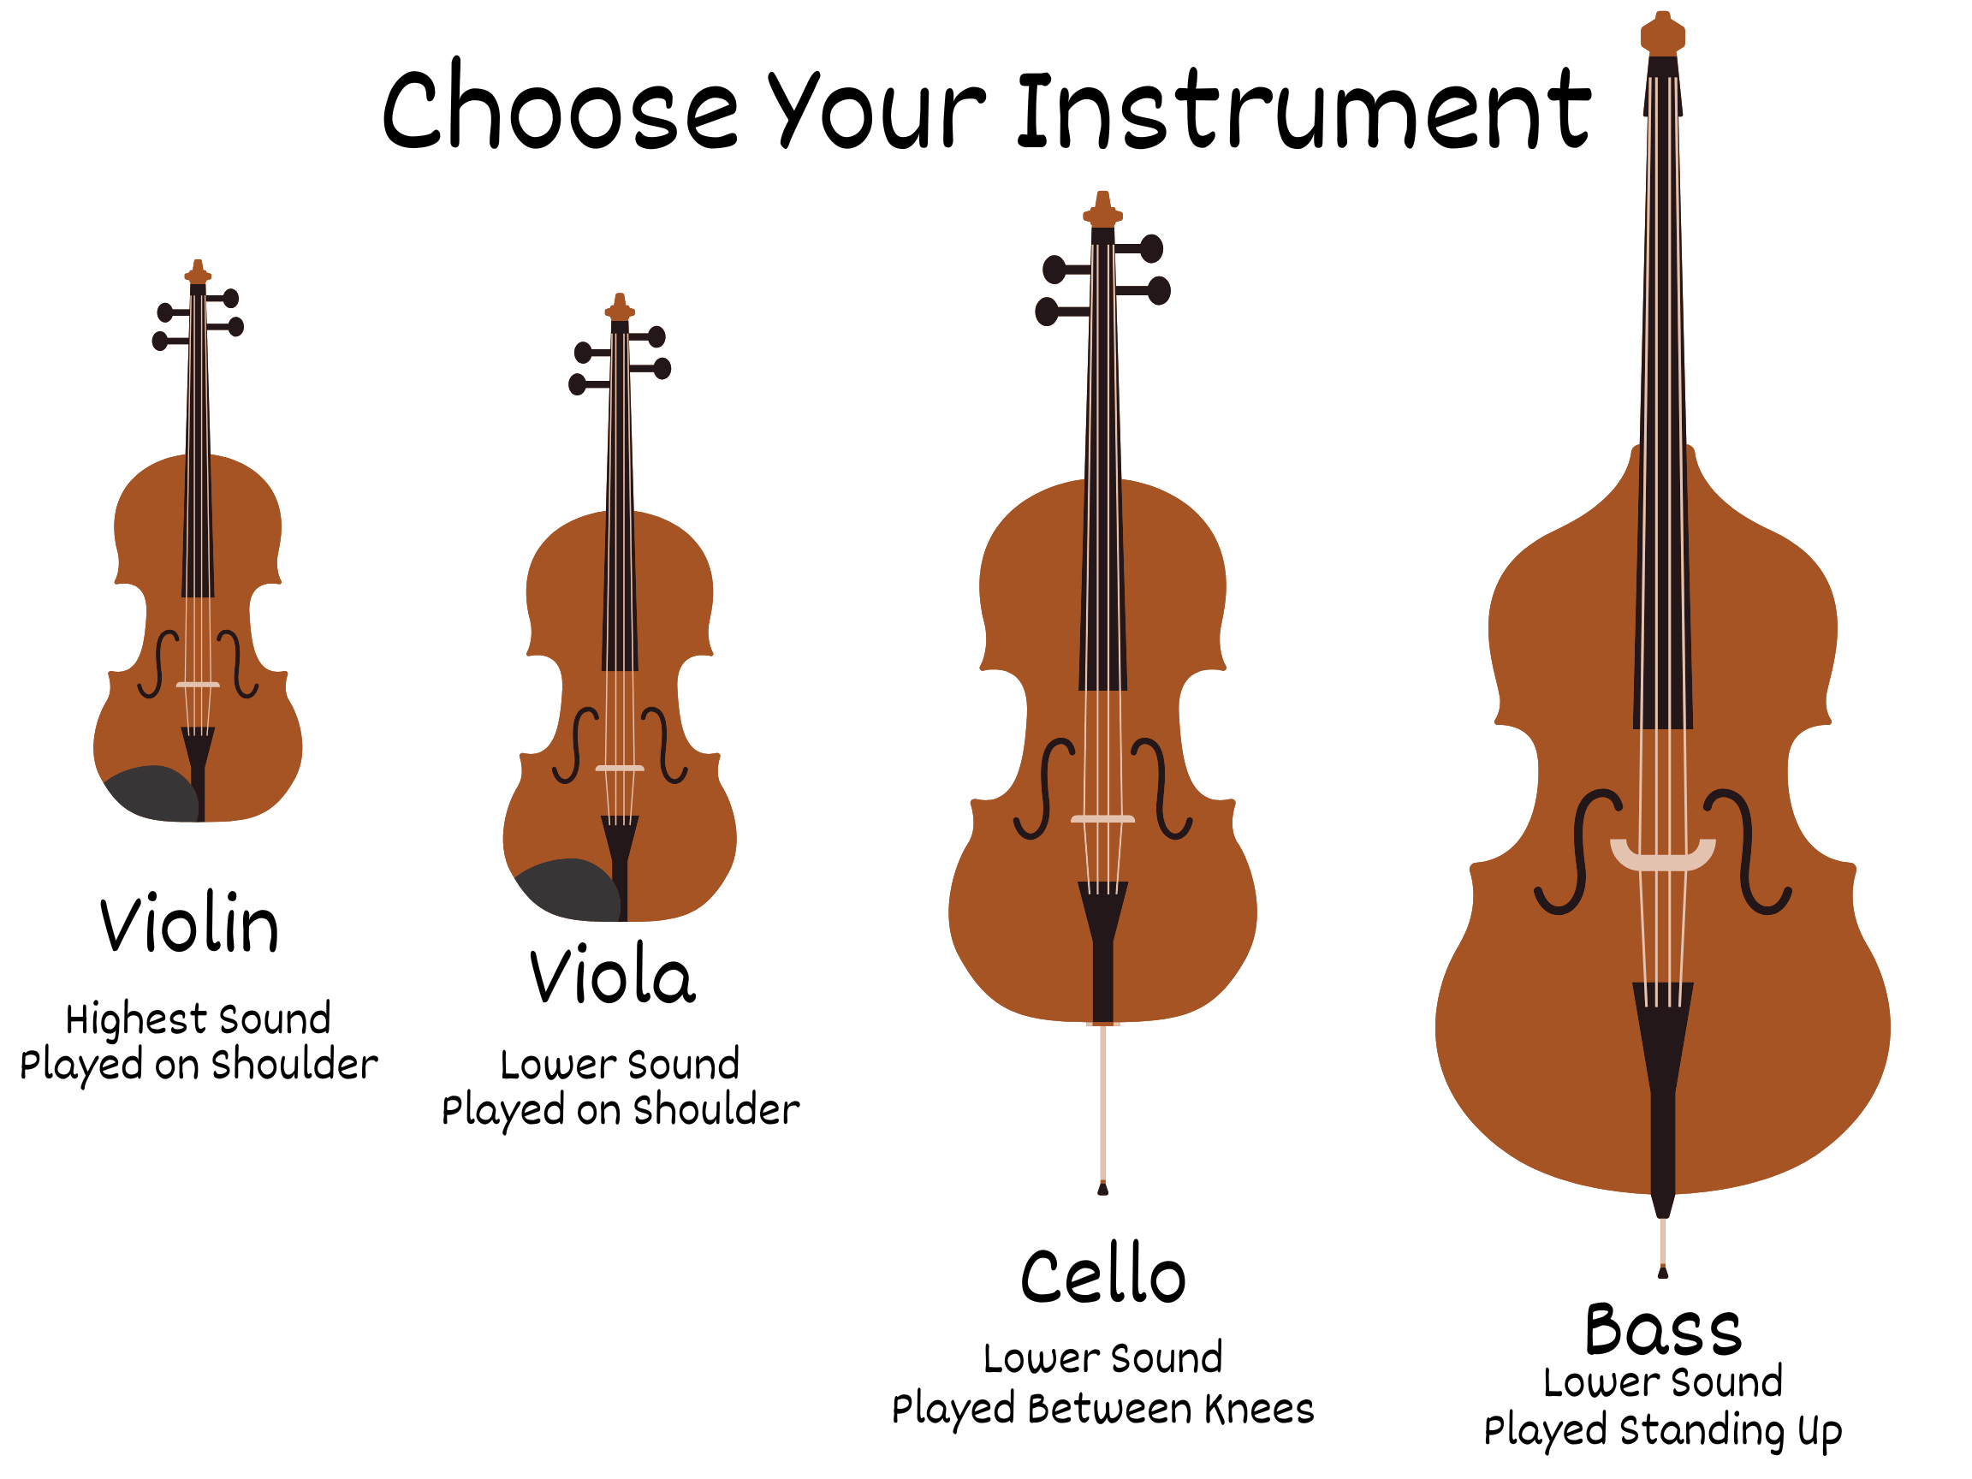

Slide 5
Click Here

Slide 6
